Slide 1
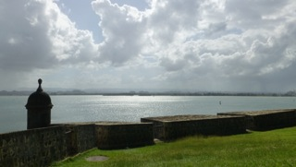
Puerto Rico The 21st Century Colony
Enrique Sabater
ENG 101 – 002

Slide 2
Where
Is Puerto Rico?
What
Is Puerto Rico?
Why
Did I Choose Puerto Rico?
- my goal

Slide 3
WHERE?
100
35
Screenshot of GoogleMaps

Slide 4
“The present is defined by its past”
OH BRAVE NEW WORLD
Nov 19, 1493
Spain – azúcar y café
Spanish American War
Gen. Nelson Miles (17 days)
Title: territory
Foraker Act (1900)
Jones Act (1917)
Land for the people military
Luis Muñoz Marín – 1st elected gov.
Notes:
The Foraker Act of 1900 regulated political and economic relations between PR and USA and organized a civil government, where the US president appointed all governors.
In The Jones Act of 1917 the US Congress grants Puerto Ricans US citizenship and provided for the creation of a local senate.
LMM a hero → fought for independence, saw only failure, aimed to preserve the PR nationality

Slide 5
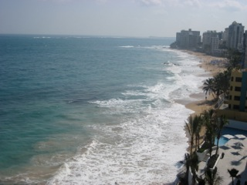
What Is Puerto Rico?
What is a nation?
“A large aggregate of communities and individuals united by factors such as common descent, language, culture, history, or occupation of the same territory, so as to form a distinct people.” - Oxford English Dictionary
What is a colony?
a group of people within a set area or designated district controlled by a father country
What is a country?
What is a state?
Is Puerto Rico a stateless nation?

Slide 6
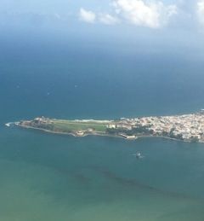
A Commonwealth
Territory of US
Passports, currency, postal service, armed forces
Federal Court applies
Semiautonomous
No fed. Taxes
No vote
Limited representation in Congress
Notes:
Commonwealth since Since 1952
Territory since 1900 (officially)

Slide 7
Modern Time Modern Struggle
“citizens” without a voice
Political influence?
UN representation?
Strict international commerce
+ foreign | - local | commerce
Bi-partisan political parties
Public debt
Can bankruptcy be avoided?

Slide 8
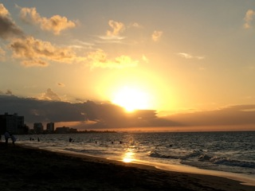
The NEW Problem:
PROMESA
Puerto Rico Oversight, Management, and Economic Stability Act
“verguenza”
Balance budget and restructure debt
Totalitarian control
American Imperialism in the act
Semiautonomous

Slide 9
What about the people?
Is there a hopeful future?

